Slide 1
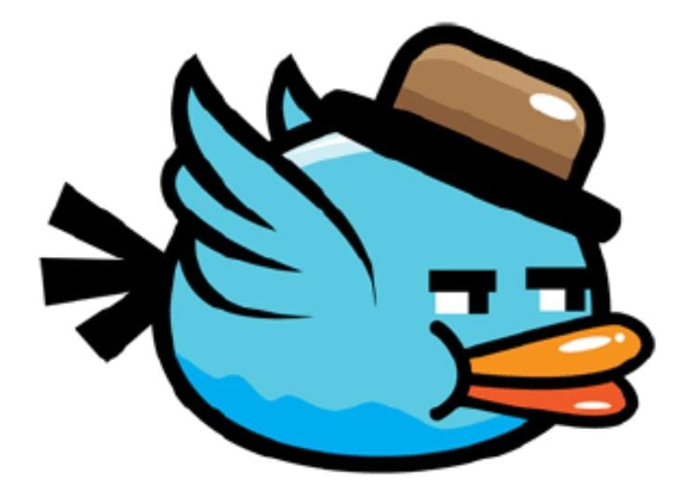
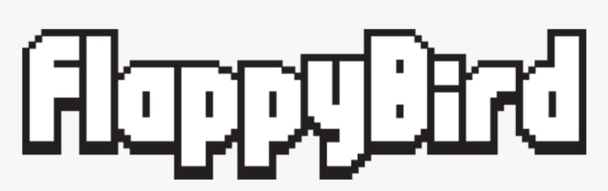
2D Flappy Bird Game
G.Varshini-AP23110011567
D.Gopika-AP23110011571
B.Poojitha-AP23110011560

Slide 2
Introduction
The Flappy Bird game is a popular side-scrolling mobile game that gained widespread popularity due to its simple yet addictive gameplay, In the game, the player controls a bird, guiding it through
a series of green pipes that have gaps in them. The objective is to navigate the bird through the gaps by tapping on the screen or pressing a key to make the bird flap its wings, causing it to ascend momentarily.

Slide 3
Project Objective
Our objective for this project is to increase features of original classic game .We try to create user-friendly interfaces to allow user better understand the game instructions and workflows. The game allows users to choose playing modes and background settings, and to control bird using touchscreen or keyboard buttons. It also contains a score board function to track previous history.

Slide 4
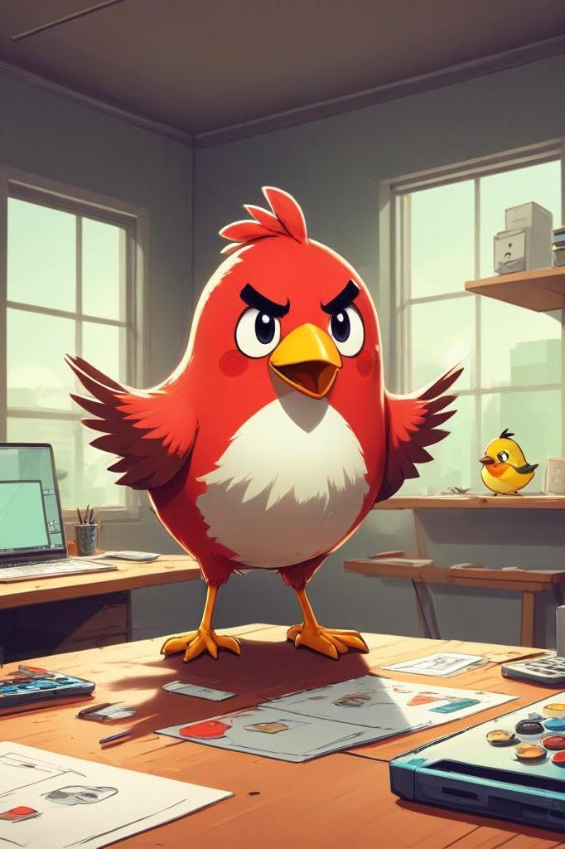
Design
Our design process is to first create all static interfaces and buttons associated with current interface. Then we started to create single player mode, including pipe and background shifting, bird falling or jumping, score and life tracking, sound effect. Then we tried to add extra new features like
Theme-toggling:Dark theme,Light theme
Music
Multiple birds
Speed booster
Level ups
Pause-Play Options

Slide 5
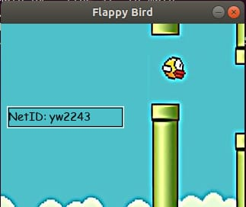
Testing
Functional Testing: Verified core mechanics (bird flap, pipe movement, scoring, collision, pause, theme switch,music,bird selection, high score).
Usability Testing: Ensured intuitive controls and clear feedback (tutorial, dashboard readability).
Performance Testing: Monitored frame rate for smooth gameplay under various conditions (normal play, level changes).
Edge Case Testing: Checked behavior at screen boundaries, during rapid actions, and with high scores.
Positive Results: Core functionalities operated as expected, user feedback on key additions was positive.

Slide 6
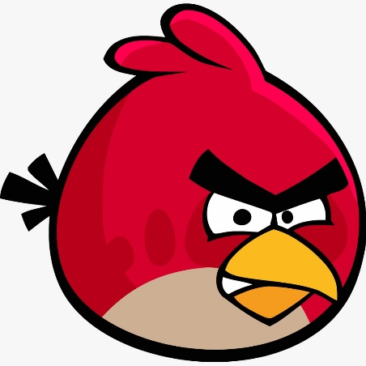
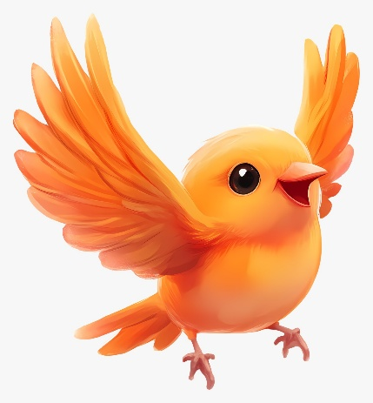
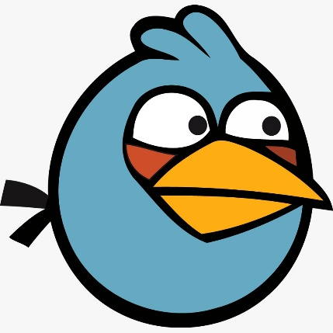
Additional features
Pause and Play options:
Speed Booster
Music
Character selection:

Slide 7
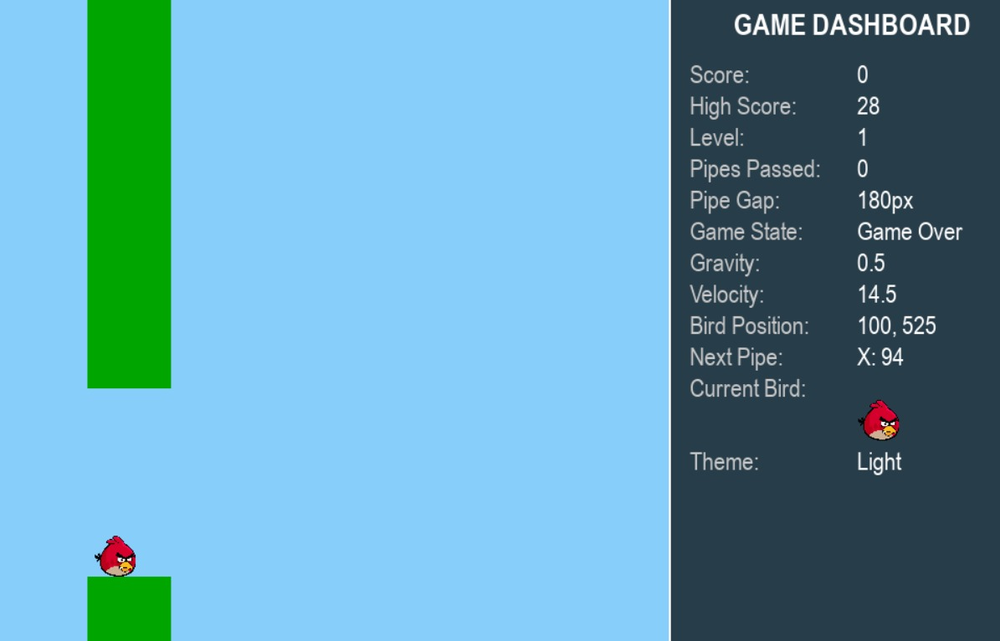
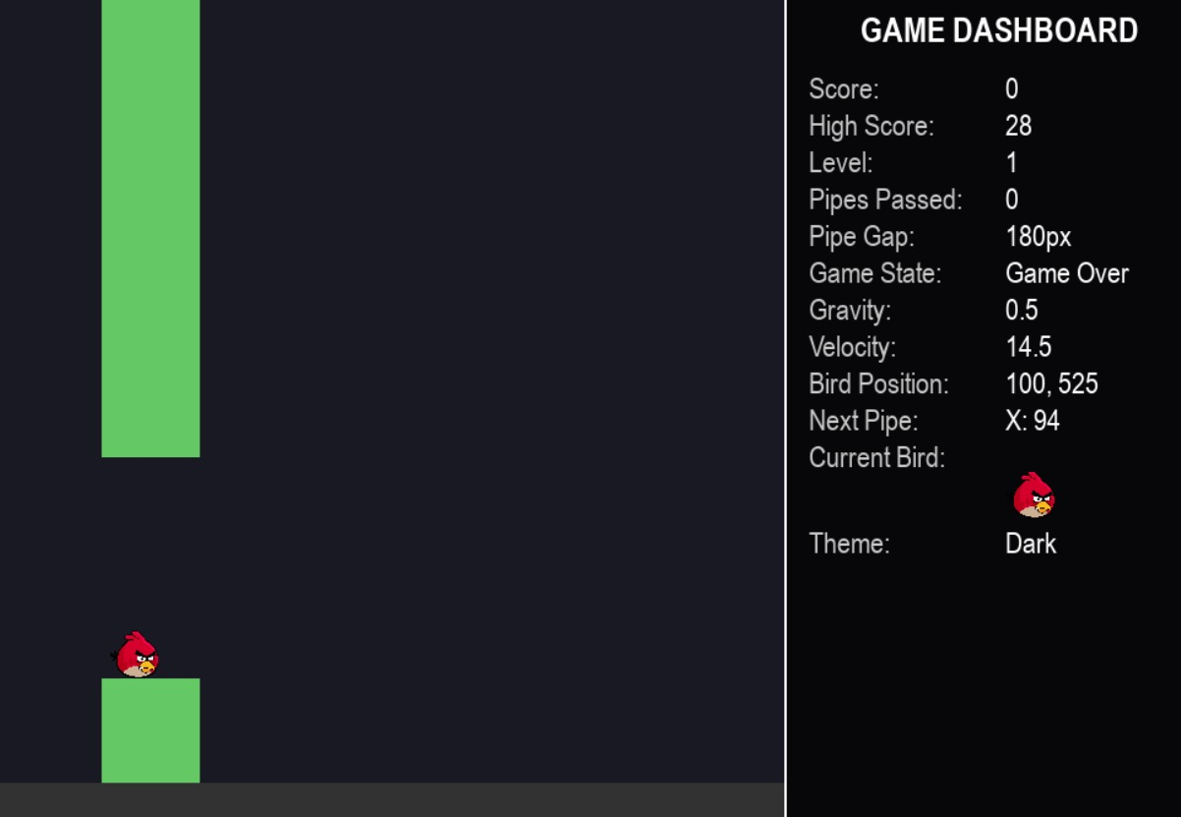
Theme:

Slide 8
Results
Everything in our project performed as planned and our team meets the goals outlined in the description. We designed a new flappy bird game with additional features to encourage more users to play and enhance user experience to not be bored of original classic style.

Slide 9
Conclusion
The implemented Flappy Bird game successfully recreates the classic core gameplay while integrating several value-added features such as visual themes, a real-time dashboard, dynamic difficulty scaling through level progression, a helpful tutorial, pause functionality, and persistent high score management.

Slide 10
.
Thank You

